Slide 1


GlassBox AI – A Fairness Detector for Filtering Models
SAP HACKFEST 2025 A National Level Hackathon – SAP Round
Theme: Ethics in AI Models for Businesses - Ensuring Responsible Innovation
Presented By:
Team V - SSN College of Engineering
Vijay K (3122235001157)
Bysani Vishal (3122235001161)
Varsha M (3122235001153)
Varun P (3122235001154)
Vishal S (3122235001163)

Slide 2





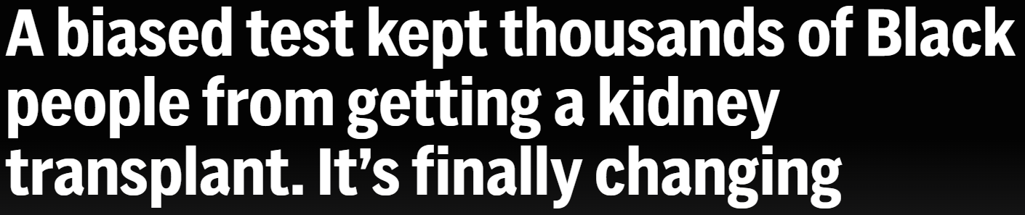
Problem
Impact
Biased and opaque AI harms individuals and undermines trust by:
Discriminating against marginalized groups
Lacking decision transparency
Risking legal and ethical violations
Eroding public trust
Businesses are increasingly integrating AI into critical decision-making areas such as:
Hiring
Healthcare
Insurance & Lending
Leading to serious concerns around fairness, accountability, and transparency.
Notes:
https://www.euronews.com/business/2018/10/10/amazon-scraps-secret-ai-recruiting-tool-that-showed-bias-against-women
https://apnews.com/article/kidney-transplant-race-black-inequity-bias-d4fabf2f3a47aab2fe8e18b2a5432135
As businesses increasingly integrate Artificial Intelligence (AI) into critical decision-making areas such as hiring, healthcare, insurance, and lending, serious concerns have emerged around fairness, accountability, and transparency.
AI systems can unintentionally discriminate, leading to biased outcomes that adversely affect individuals and marginalized groups. Moreover, the lack of transparency in AI decision-making processes leaves end users in the dark, unable to understand or challenge outcomes that impact their lives.
Organizations also struggle to detect, measure, and manage bias in their AI systems, making it difficult to ensure regulatory compliance, maintain ethical standards, and build public trust.

Slide 3
Situational Biases, Examples
Biased Class Weights
Indirect proxies
Bias caused by overfitting to a majority-group testing data.
For example, preferences of common users with incomplete data to tribals with complete documentation for loan approval
Group A was underrepresented in the training data, which led to biased decision-making by the model. As a result, individuals from Group A were unfairly denied access to critical services or resources.
Due to using location as a proxy, model rejects promising candidate from a marginalized community due to low historical hiring rates from that zipcode.
Rejection of female candidates who have taken maternal leave as historical data shows resume gaps unsuccessful

Slide 4
Situational Biases - Continued
Bad Training Datasets
Marginalization
A Bad dataset which may not be the true representation of the population may make the model think that one class is significantly better than the other
Women being rejected from various jobs as they’re deemed to be less qualified by the model
When a model faces a new set of class, or a new set of variables previously untested, it naturally assumes that its unsafe, therefore rejecting them
People applying for loans the first time might not have a credit score, thus flagging them as unsafe

Slide 5
Problem Statement
Considering all of the previously stated factors, we define the problem statement as follows:
Lack of Transparency : Increased deployment of AI models in critical areas like hiring, lending, and insurance without providing clarity on how automated decisions are made.
Unintentional Bias: AI systems often reflect biases present in historical training data, leading to unfair outcomes for certain groups — especially minorities, women, or people with disabilities.
Trust Gap with End Users: Consumers and applicants often feel powerless or uninformed when rejected by AI-driven decisions, which undermines trust in the business and its technology.
Lack of Tools for Continuous Fairness Monitoring: Existing systems focus heavily on accuracy and performance — overlooking real-time bias detection, version tracking, and meaningful logs for audit or end-user reporting.

Slide 6







Overall Solution Workflow
Bias Engine Checks
Logs Saved
Alert Generated/ Results Shown
Model Predicts
AI Audit Workflow Diagram
Data Submitted
User Views
Dashboard
This flowchart shows how GlassBox AI audits models step by step.

Slide 7
USPs of GlassBox AI
Audits AI model decisions
01
Detects drift and bias
Keeps record of the AI’s decision-making for later analysis - any discovered biases are immediately flagged.
02
It checks if the AI starts treating people unfairly or if the data has changed over time.
Logs timelines of inferences
03
Displays compliance insights
It saves each AI decision along with the time it happened, enabling us to see snapshots of decisions and help for RL.
04
It shows whether the AI is following rules and fairness standards through easy-to-read reports.

Slide 8
05
Uncovers Deep & Proxy Biases
Simulates Adversarial Cases
06
It examines not just direct features, but also hidden correlations (zip code ↔ race) and class imbalances as well.
Uses adversarial AI to generate thousands of synthetic scenarios to test model robustness and uncover hidden vulnerabilities.
Provides Public Fairness Scores
07
Each model gets a live fairness score. If bias is detected, the score drops, and certification can be revoked.
Enables Model Reinforcement
08
Empowers Whistleblowers
Offers access to logs, failed cases, and synthetic edge tests to retrain and improve models using reinforcement learning techniques.
09
Users can directly test models with real data like resumes. It’s a direct channel for external validation and bias exposure.

Slide 9
8. Key Partners |  | 2.Value Propositions |  | 1. Customer Segments
6.Key Activities
7.Key Resources
3.Customer Relationships
4.Channels
Building and maintaining the bias detection engine
Partnering with developers and companies for integrations
Logging and securely storing AI decisions
Ensure legally compliant and inclusive hiring with transparent, bias-free recruitment tools that improve diversity and reduce discrimination risks—saving time and reputation, e.g. HR managers
SAP
Onboarding support for companies integrating their models
Community support and whistleblower protection channels
HR officials – e.g. tech companies
AI developers
Open-source libraries
Monitoring model drift and revoking fairness scores
Running adversarial simulations for robustness testing
Incorporate general public in our model to make companies realize importance of fair AI Models
User dashboard for transparency and feedback (end users)
Insurance companies
Auditors e.g. banking companies
Proper Loan and Insurance approval for customers without having any sorts of preconceived biases – useful for Insurance officials and Banking officers
Creating dashboards and explainability interfaces
Our Detection model is not Biased
Helpdesk or chat support for technical and audit queries, especially for companies
Leveraging the outreach of SAP to campaign about the features of our benchmark
General Public
Build fair, trustworthy AI models with one-click audits, deep bias diagnostics, and certification tools—accelerating deployment while meeting ethical and regulatory standards. Helps companies develop proper AI Models which might also aid other customer segments
Dataset Providers
Admin for maintaining the dashboard
Servers to host our website and give 24/7 access to API
Fairness Certification from SAP, Providing a quality standard
B2B Direct Sales to companies through demos and SAP marketplace
Computational power for the AI to make decisions
Training corpus
Utilize SAP Tools like BTP, HANA, SAP AI and Cloud
Web Platform for users and businesses to upload data/models
Compliance consultants
Experts for all fields covered
Support from the General Public in the form of Testers, whistleblowers, and Data Contributors
Provide high-level rejection feedback and empowering simulations that reveal and correct hidden biases, which lets the general public know the validity of decisions.
SAP Technologies to maintain and store Large amounts of data
Public Website and Dashboards for transparency and branding
APIs to integrate into company model pipelines
Training corpus abundantly available
9. Cost Structure | 5. Revenue Stream
Cloud Infrastructure & Hosting: Ongoing cost of running fairness audits, storage of decision logs, and blockchain operations.
R&D for Fairness Models: Salaries for AI/ML researchers and developers building and maintaining bias detection and explainability tools.
UI/UX Development: Designing and updating dashboards, APIs, and user feedback tools.
Model Hosting fee computed monthly or annually
Detailed analytics reports for internal compliance audits, specially individualized for companies
Partner with companies to build models from scratch
Costs should reflect the value of the service and be on par or less than the industry standard
Security & Blockchain Maintenance: Ensuring immutability and compliance through blockchain-based audit logging.
Compliance & Legal Advisory: Costs associated with keeping up with global fairness regulations and standards.
Marketing & Onboarding Support: B2B sales, training programs, documentation, and enterprise integration assistance.
Recurring revenue for access to logs from the blockchain
Private operators may have increased revenue due to their lessened standards
Retrain models for companies when they models fail – Charged on case-by-case basis
Private operators may have decreased costs due to their lessened standards
Open-source tools and SAP Technologies to be leveraged wherever possible
Certification and re-certification fees for each model
Notes:
Survey Responses: https://docs.google.com/forms/d/1e7MaZpY6zHjsNT2vNFeU7t1zjNhs-erB8AMo2LHeQNo/edit#responses

Slide 10
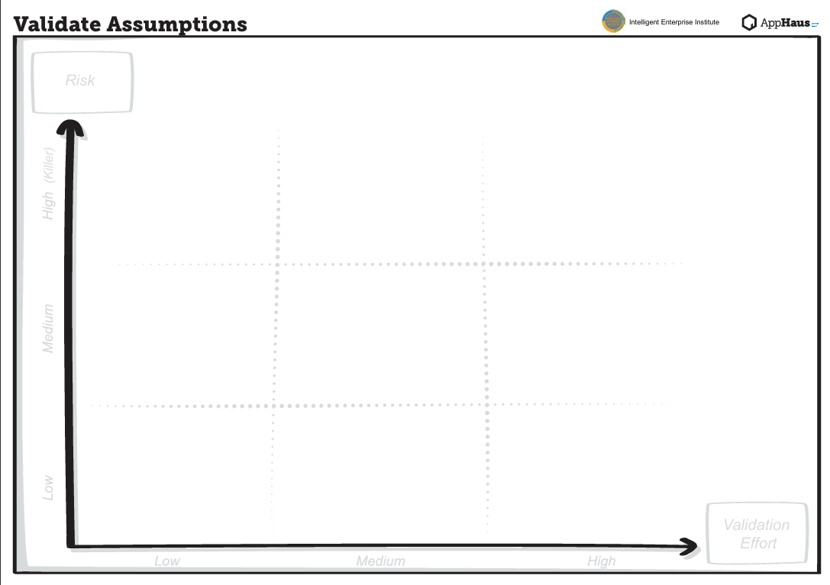
Integration into every model is possible
This is only a evaluator Engine
Perfect Bias Detection
Enterprises will pay for certification
Enterprise interviews for feedback
Initial Stages not fully possible
Success Rate:30%
Training data is unbiased
Companies are willing to share fairness scores
Trust and Brand reliability Matters
Customer Satisfaction
Feedbacks and Comments
General Public Cooperation
Success Rate: 45%
Estimated Success Rate:50-60%
Mutual Gain
Customer Values a certified model
Recent Trend Analysis
Necessity of the problem
Validated through extensive survey
Did not add unnecessary features
Features as per industry

Slide 11
SAP Tools Powering the GlassBox AI Platform
Tool | Role in GlassBox AI | Purpose
SAP AI Core | Hosts and manages fairness models | Secure, versioned model execution and lifecycle management
SAP Data Intelligence Cloud | Runs bias & drift detection pipelines | Real-time analysis, scheduling, and retraining of AI models
SAP Event Mesh | Sends bias alert notifications | Enables real-time, event-driven alerting to stakeholders
SAP HANA Cloud | Stores logs and metrics | High-speed storage for inference logs, audit trails, and fairness data
SAP Analytics Cloud | Powers compliance dashboards | Visualizes bias metrics, trend reports, and audit outcomes
SAP Integration Suite | Connects HR, finance, and external tools | Enables secure flow of business data into the fairness pipeline

Slide 12
Our Edge Over Other Tools
Feature | Traditional Fairness Tools | Glass Box AI
Controlled dataset tests | ✅ | ✅
Real-world whistleblower testing | ❌ | ✅
Transaction-level internal logs | ❌ | ✅
Blockchain log storage | ❌ | ✅
Public Fairness Score + Certification | ⚠️ | ✅
Deep bias types (proxy, transitive, adversarial) | ❌ | ✅
Model repair via RL & adversarial sims | ❌ | ✅

Slide 13
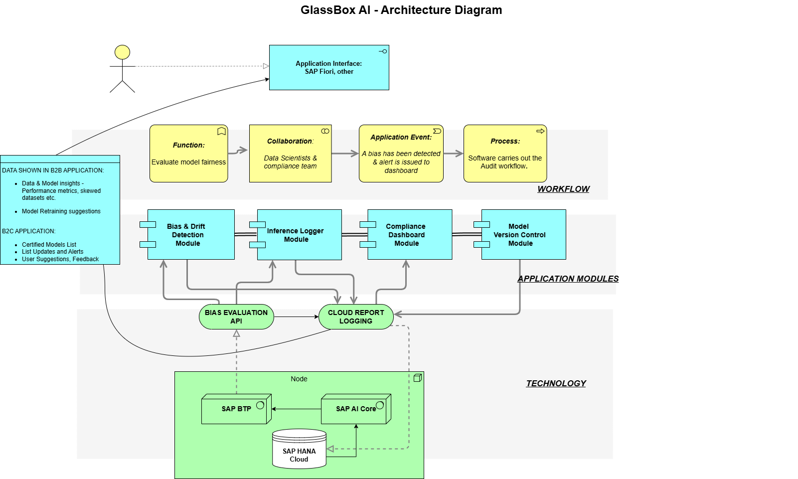
Architectural Diagram

Slide 14




Impact & Benefits - Benchmarks
Human-Readable Explanations
Provides clear, understandable reasons behind AI decisions - no black box.
Real-time Detection
Instantly flags bias or model drift as it happens, enabling quick response.
End-User Trust & Regulatory Readiness
Boosts user confidence and helps meet compliance and fairness standards.
Timeline Logs for Backtracking
Detailed logs let teams trace every decision step-by-step for audits or investigations.

